Slide 1
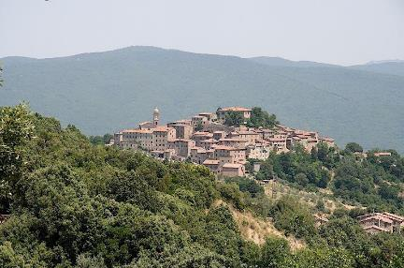
Cultivating Imaginative Cognition: The Time is at Hand!
Pari 2024
Jonathan M. Code

Slide 2

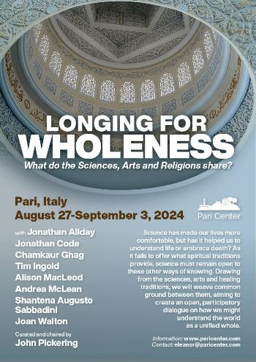
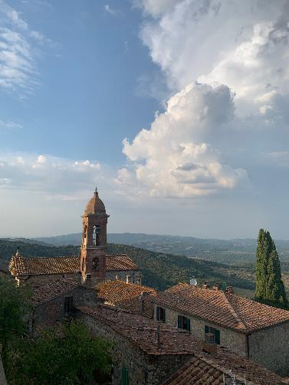
PARI Centre – Italy
https://paricenter.com/

Slide 3
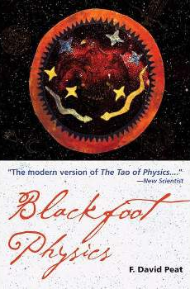

F.David.Peat

Slide 4
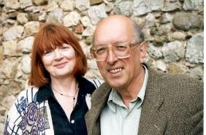
Science, Art, religion (Sacred)
In 1999 Arts Council England invited the physicist and writer F. David Peat to organize a meeting of artists and scientists in London, a meeting that would be highly informal and encourage a creative exchange. The most famous work to emerge from this gathering is Antony Gormley’s Quantum Cloud located next to the Millennium Dome in London.
Following the success of the Arts Council meeting, the Gulbenkian Foundation suggested a similar roundtable approach to discuss the role and future of universities. Since the old school house in Pari had recently been restored it was decided to hold the meeting there rather than in London or other major center.
Many participants expressed their distress at the current state of the universities and proposed that alternative structures be created. On the final day several suggested that the Pari meeting should not be a one-off, but should continue as a living center. In this way the Pari Center for New Learning was born.

Slide 5
In my contributions to the autumn week at Pari on Science, Art, and the Sacred I will draw our attention to Imaginative Cognition as it has featured in the works of Paracelsus, Goethe, Barfield, Bortoft, Steiner, and Schumacher.
I propose that a thread runs through the history and philosophy of science that has often been overlooked, misunderstood, and even derided but which—if attended to with an open mind and heart—can contribute significantly to ways of knowing and being adequate to the challenges of the day.
Through a combination of presentation, contemplation, and facilitated practical experience we will delve into the potentials of Imaginative Cognition and discover its fructifying potency for our engagement with the living world around us.

Slide 6
Wholeness….?

Slide 7
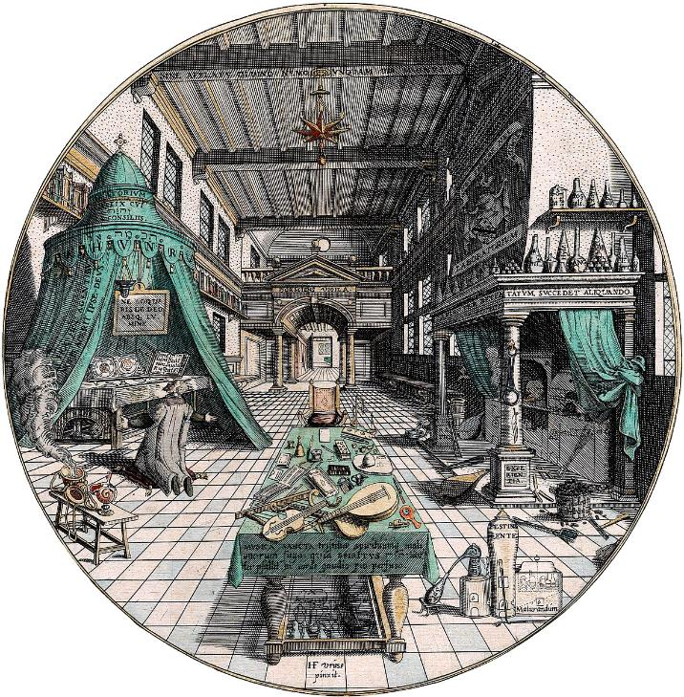
Alchemist’s laboratory. From Heinrich Khunrath, Amphitheatrum sapientiae aeternae (Hamburg? 1595). Duveen Collection, Department of Special Collections, Memorial Library, University of Wisconsin-Madison

Slide 8
Imaginative Cognition….?

Slide 9
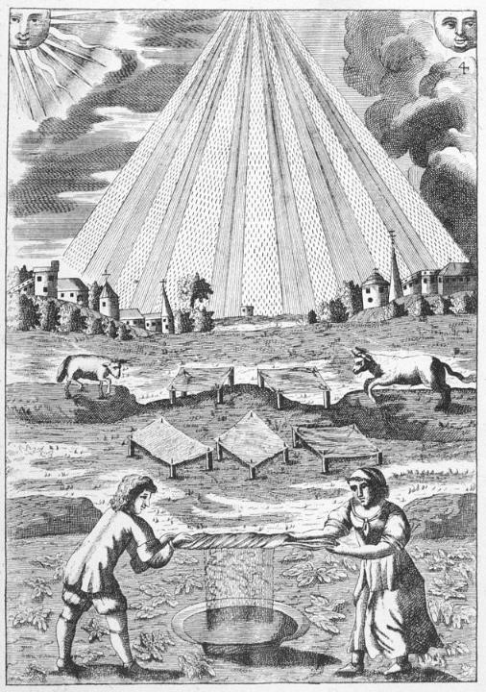

Slide 10
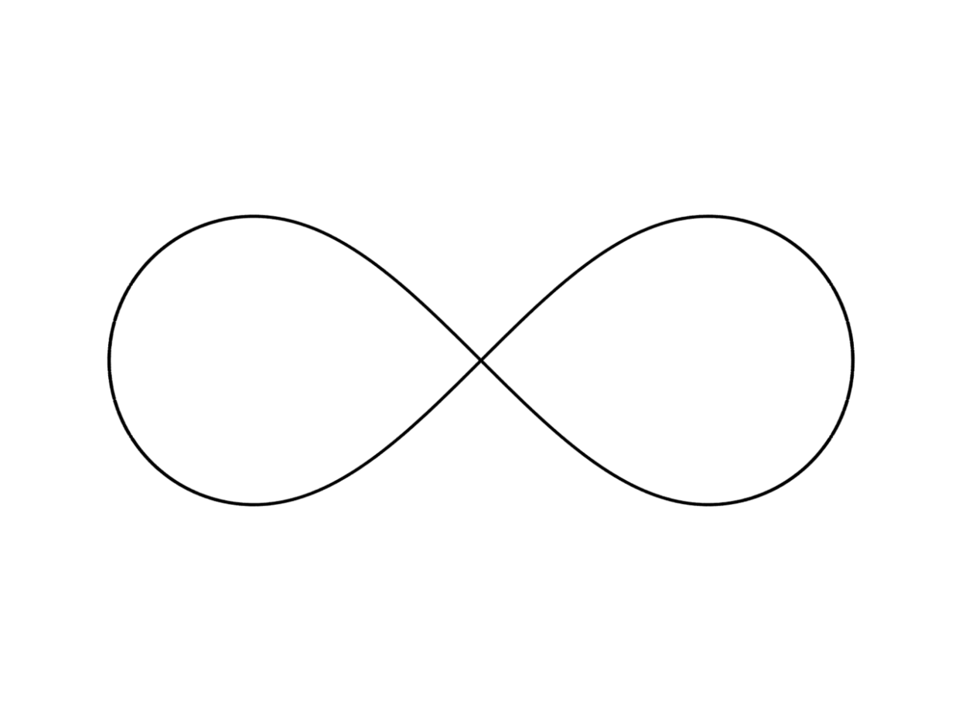

Slide 11
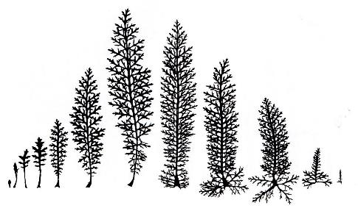
Goethe: A Science and art of Becoming
Pari 2024
Jonathan M. Code

Slide 12
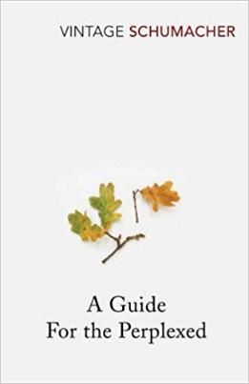
Ontological Discontinuity ‘Mind the Gap’
m + x + y + z
m + x + y
m + x
m
M
M – z
M – z - y
M– z – y - x
E.F. Schumacher

Slide 13
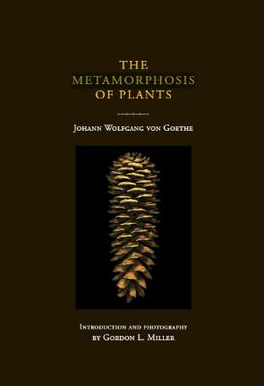
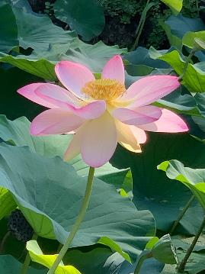
What is a way of knowing adequate to cognizing ‘x’ ?​
“The extraordinary thing about the modern ‘life sciences’ is that they hardly ever deal with life as such…but devote infinite attention to the study and analysis of the physico-chemical body that is life’s carrier. It may well be that modern science has no method for coming to grips with ‘life as such’. If this is so let it be frankly admitted: there is no excuse for the pretence that life is nothing but physics and chemistry” (Schumacher 2011:29).

Slide 14
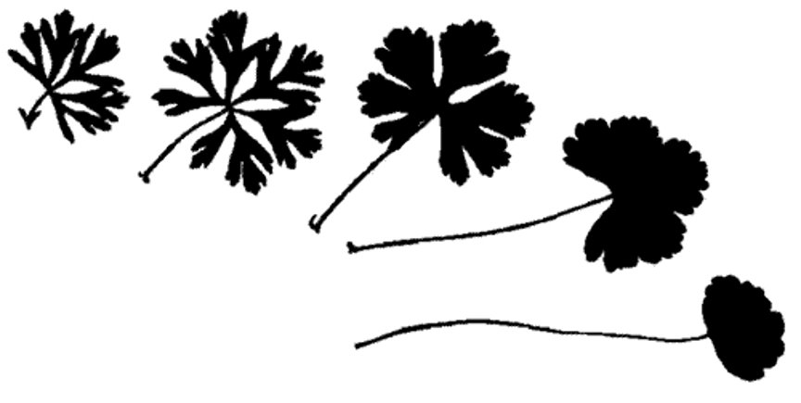

Slide 15
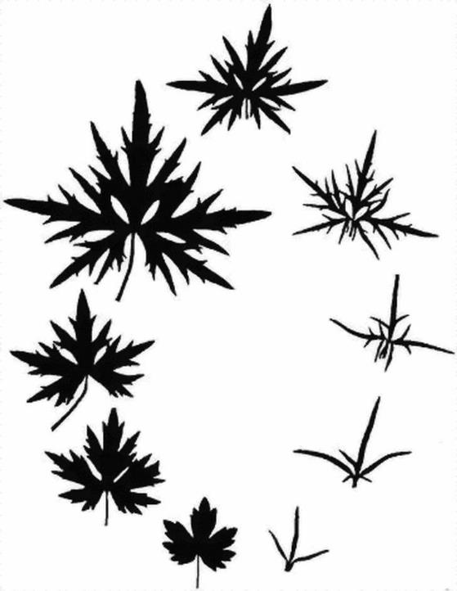

Slide 16
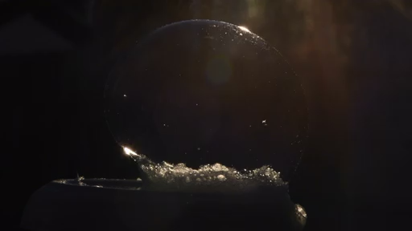

Slide 17
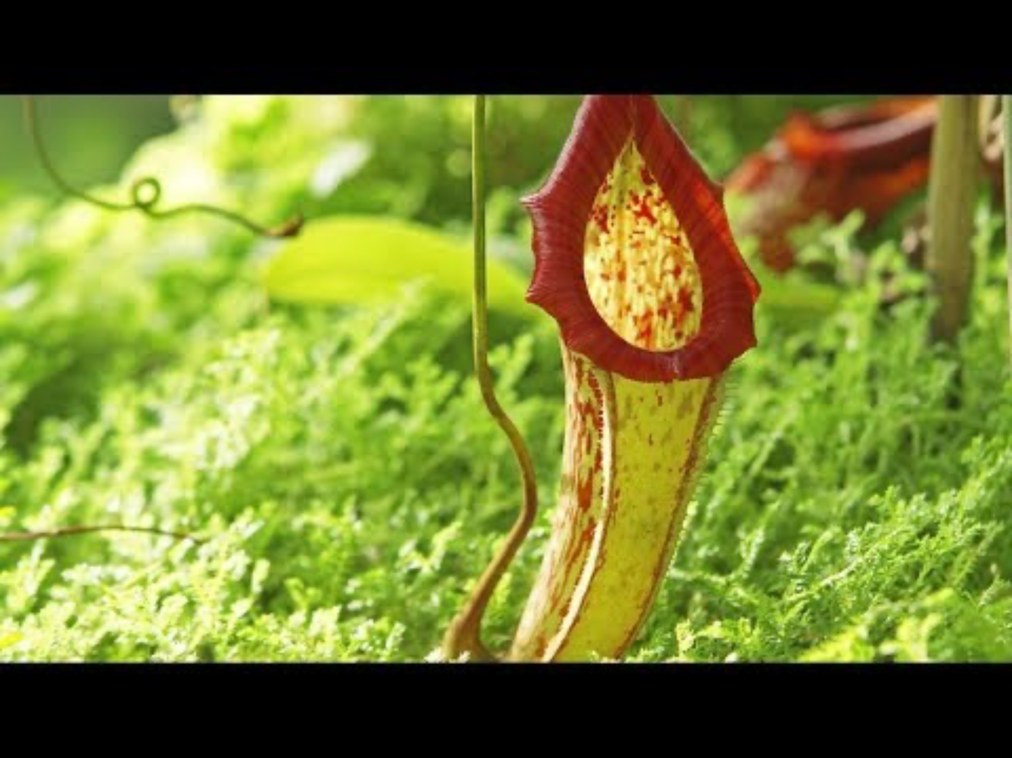

Slide 18
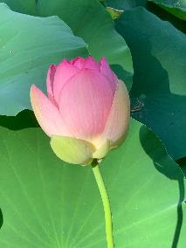
Goethe’s Exact Sensorial Imagination – a delicate empiricism
Pari 2024
Jonathan M. Code

Slide 19
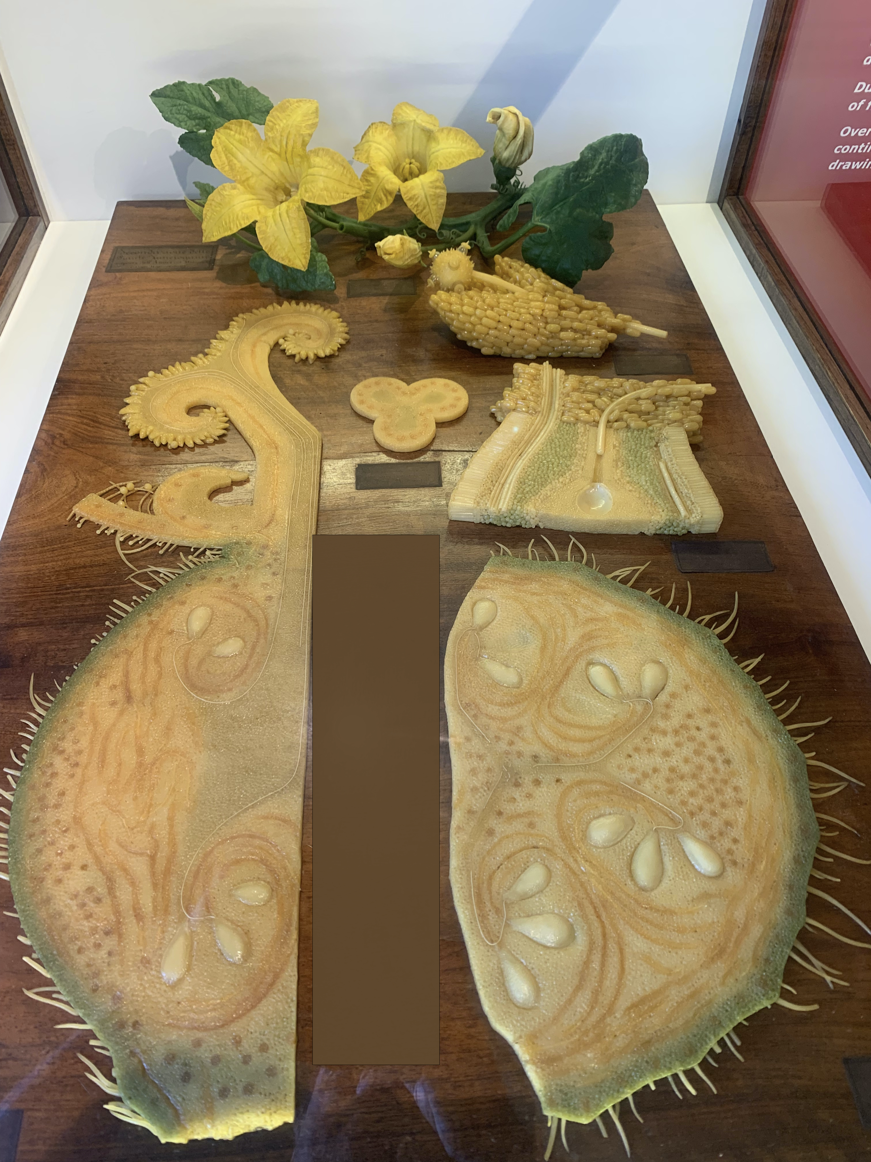

Slide 20
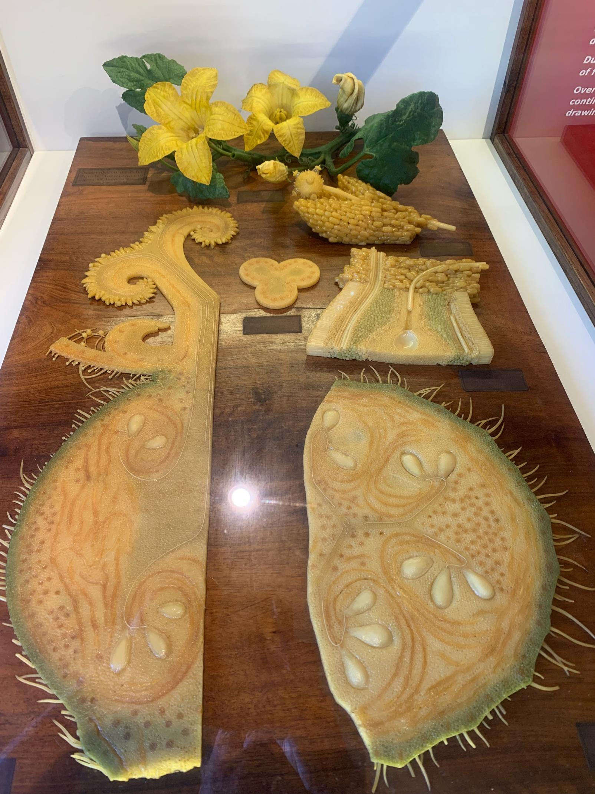

Slide 21
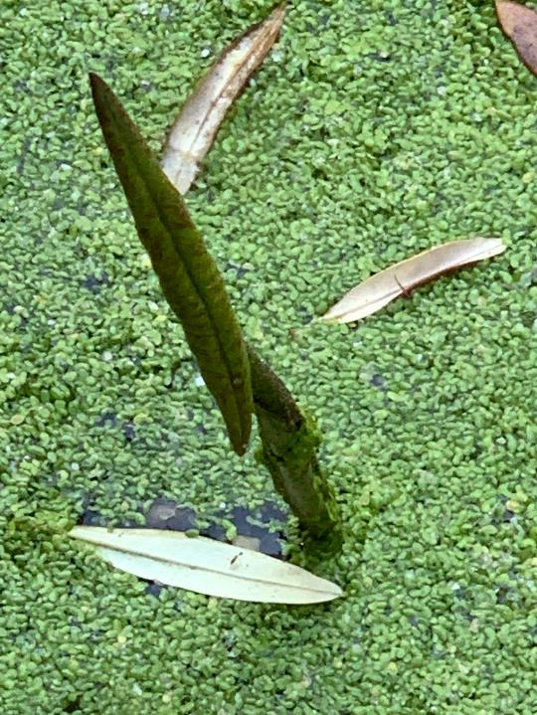

Slide 22
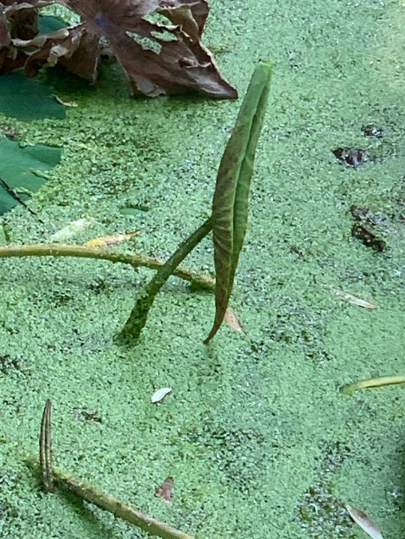

Slide 24
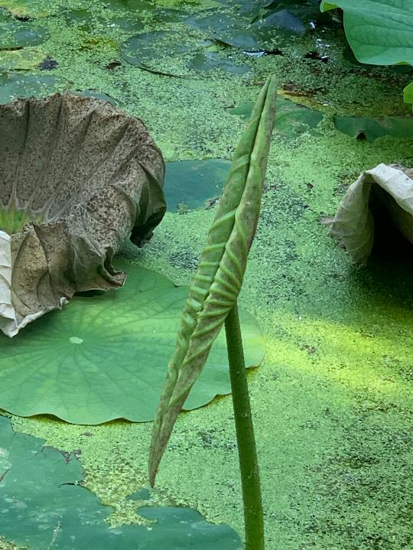

Slide 25


Slide 26
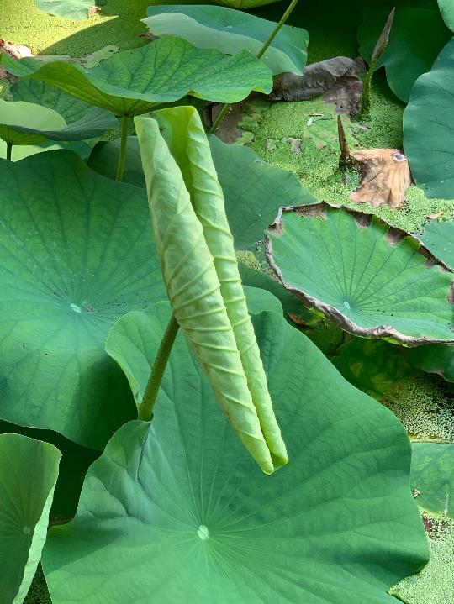

Slide 27
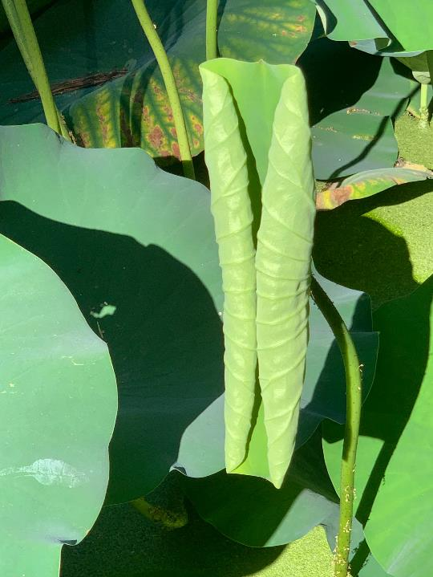

Slide 28
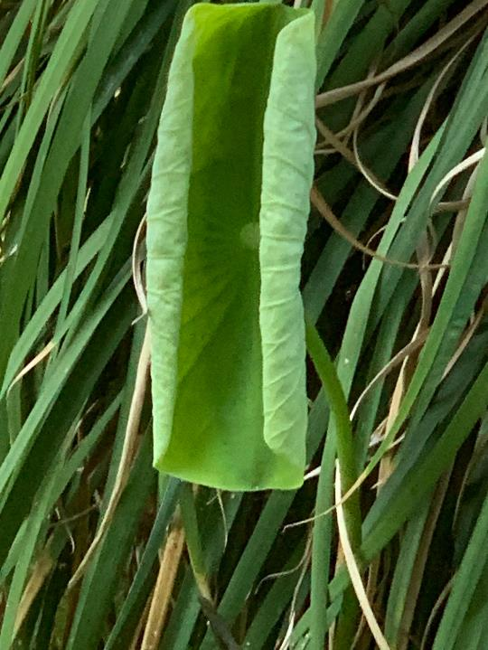

Slide 29
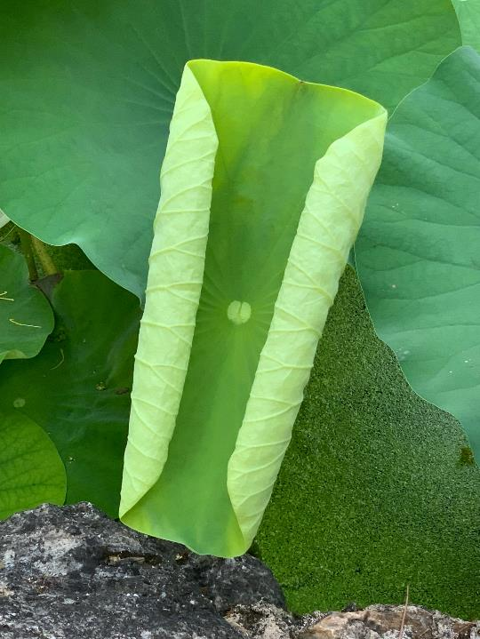

Slide 30
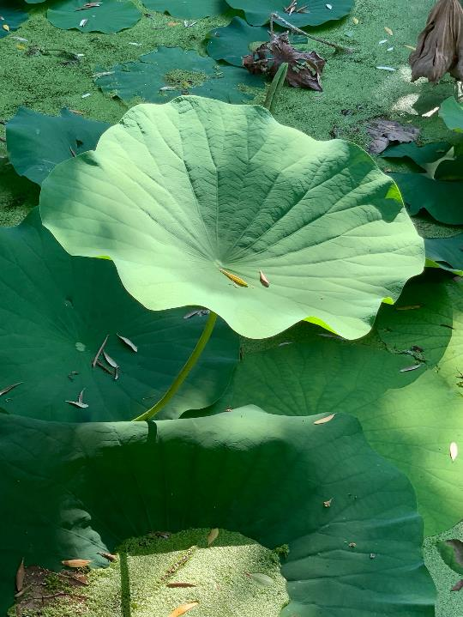

Slide 31
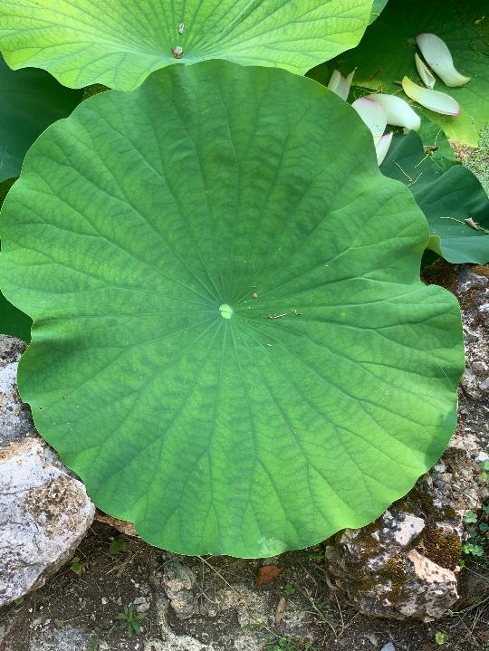

Slide 32
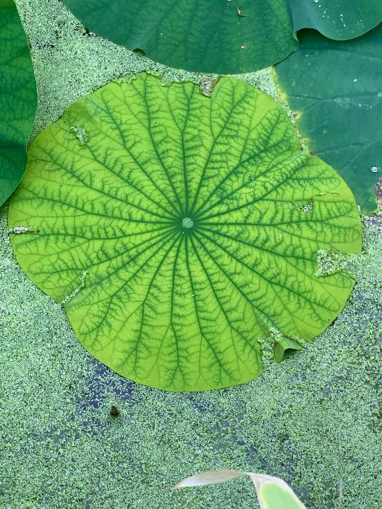

Slide 33
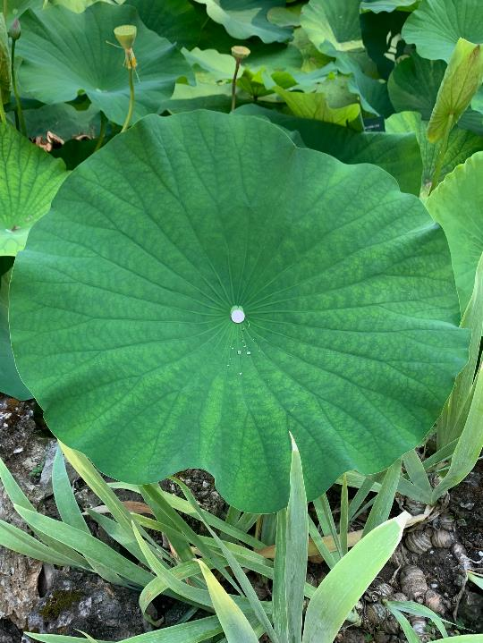

Slide 34
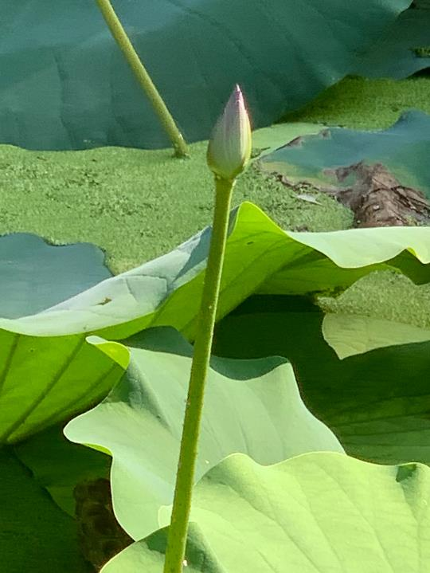

Slide 35
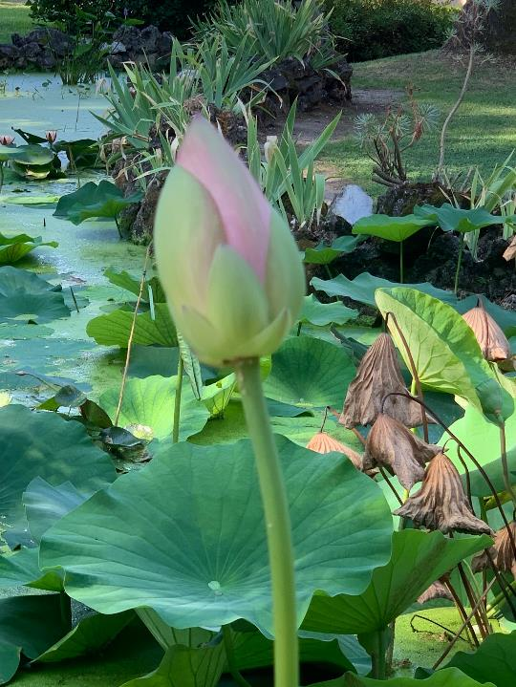

Slide 36


Slide 37


Slide 38
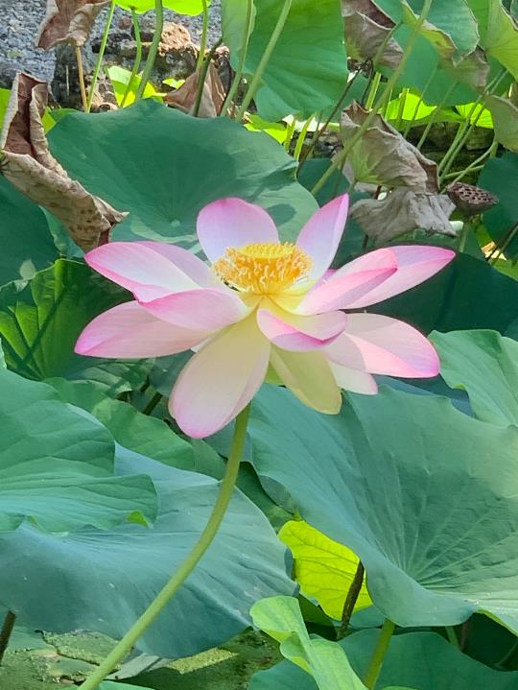

Slide 39
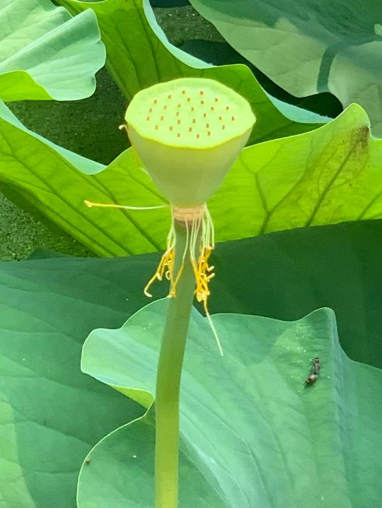

Slide 40
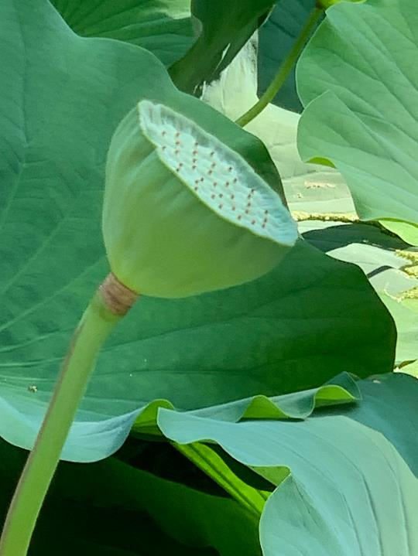

Slide 41
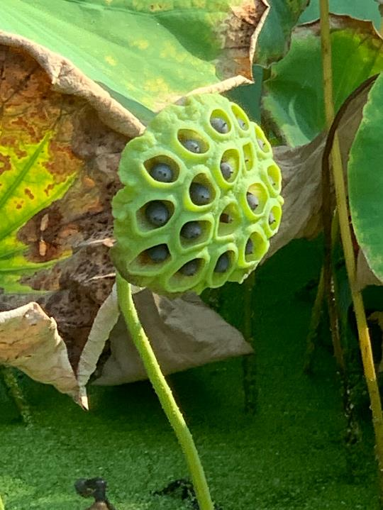

Slide 42
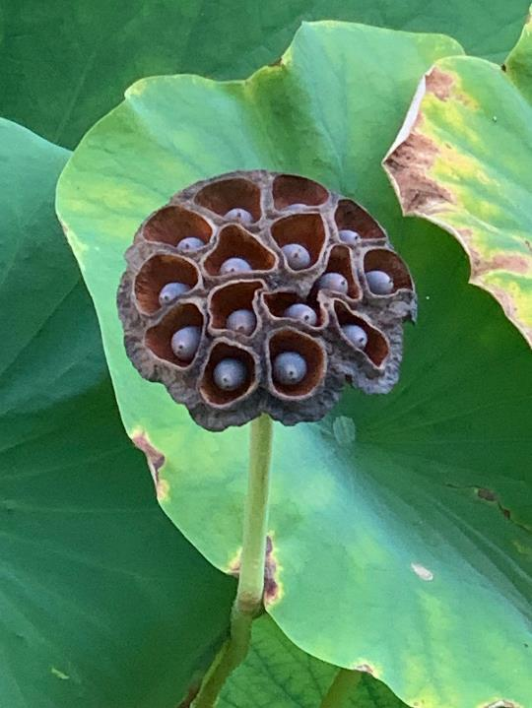

Slide 43
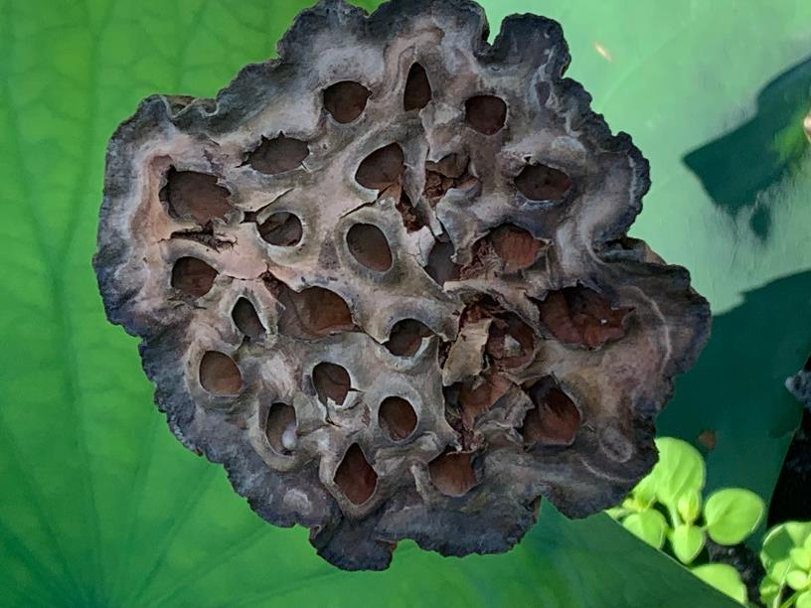

Slide 44
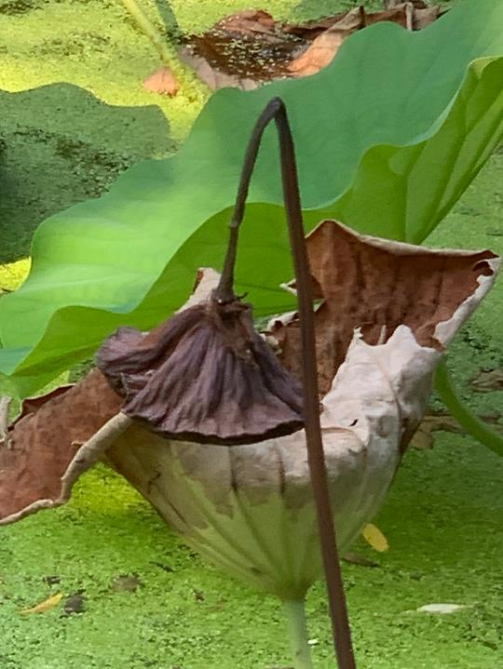

Slide 45
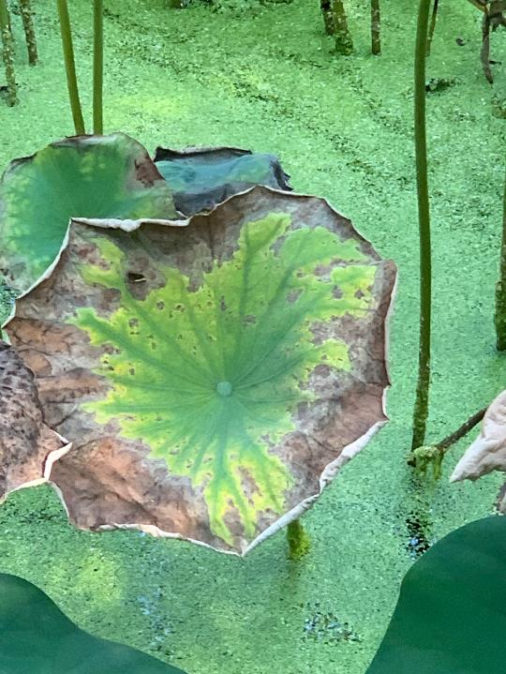

Slide 46
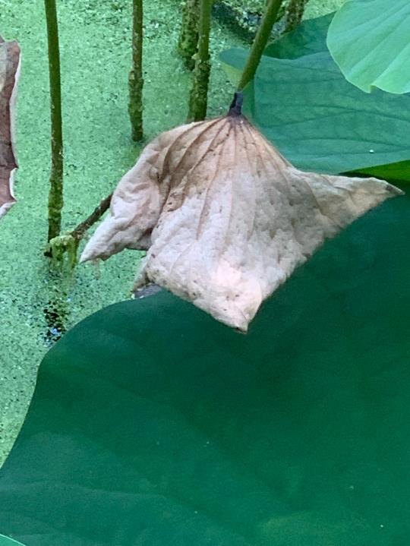

Slide 47
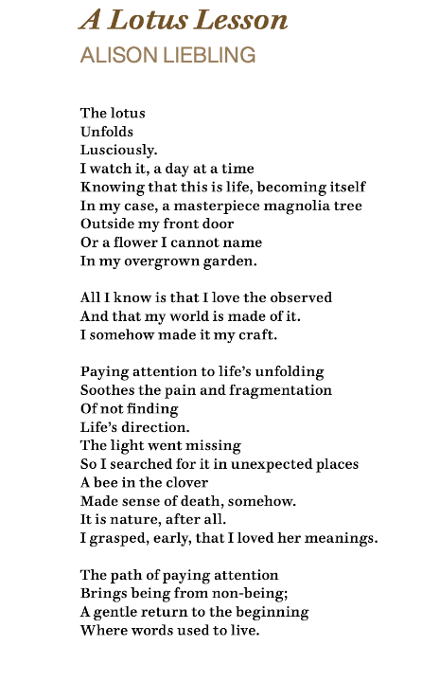


Slide 49
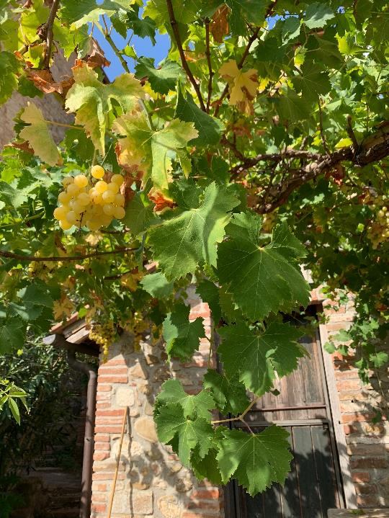

Slide 50
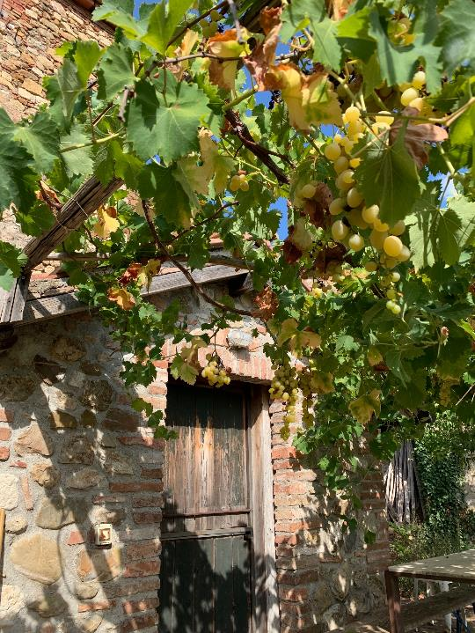

Slide 51
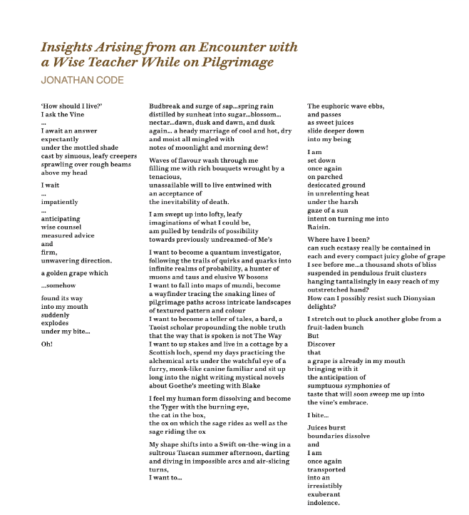

Slide 52
Imaginative Cognition
Goethean Science is a re-configuring and re-positioning of the relationship between the whole and the part, the scientist and the subject/object of science.
In contrast to focusing on the development of an artificial intelligence ever more hidden from most users in algorithms, digital code and networks obscure even to some programmers – Goethean science attends to the ‘open secrets’ accessible to sense observation and strives to develop an authentic intelligence attuned to the lifeworld.
Goethean science has commonalities with Traditional Ecological
Knowledge. It can be understood as a science adequate (Schumacher) to understanding animacy.

Slide 53
Literature on Goethean Science
‘Goethe’s Scientific Method: the road not taken’ Published as Brook, I. 2023, Ch 13 in Rist, S., Bottazzi, P. & Jacobi, J. (eds) Critical Sustainability Sciences: Intercultural and emancipatory perspectives, pp. 198-215. London: Routledge.
Ecoliteracy and the trouble with reading: ecoliteracy considered in terms of Goethe’s ‘delicate empiricism’ and the potential for reading in the book of nature, Jonathan M. Code (2019) Environmental Education Research, 25:8, 1267-1280, DOI: 10.1080/13504622.2018.1558438
Goethe’s Way of Science: A Phenomenology of Nature, Seamon, D. & Zajonc, A.(1998) New York: SUNY press
The Wholeness of Nature, Bortoft, H. (1996) New York: Lindisfarne Press

